Slide 1
A Brief History Of AI
Where we were and where we we are

Slide 2
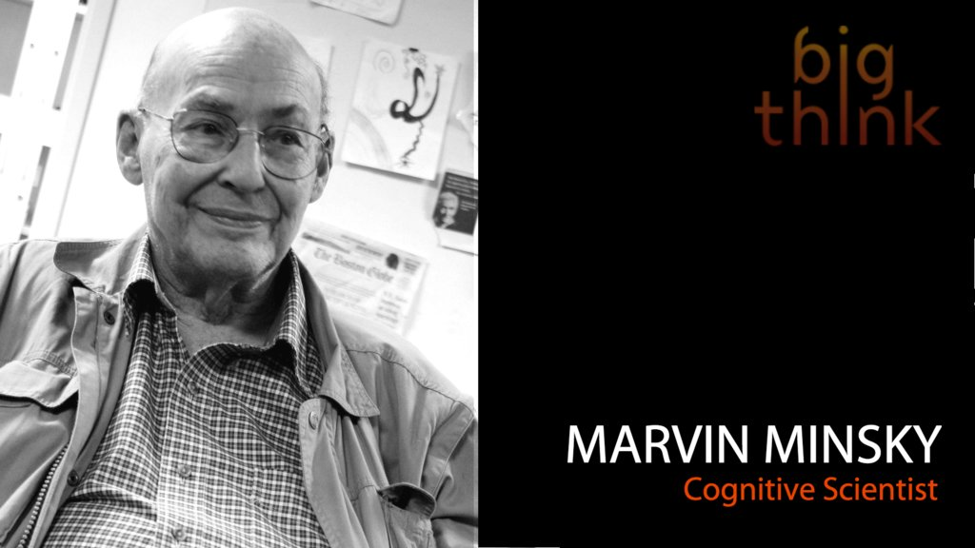
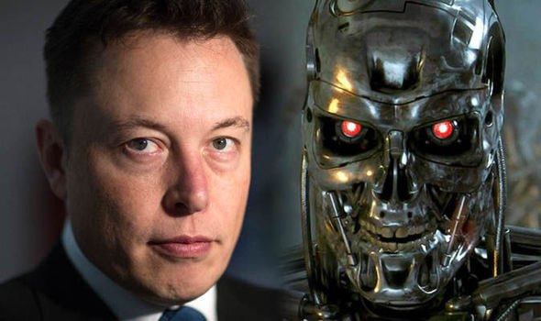
SHORT-TERM HYPE
Within a generation... the problem of creating artificial intelligence will be substantially solved
Marvin Minsky 1967
AI has gone through several hype periods fueled by early successes
AI failed to materialize and led to boom and bust cycles pushing many researchers to other fields
Two AI winters 1974-1980 and 1987-1993, where funding dried up and governments shifted focus
Disruption certainly. Deep AI is the real risk, though, not automation.
Elon Musk (@elonmusk) June 9, 2017

Slide 3


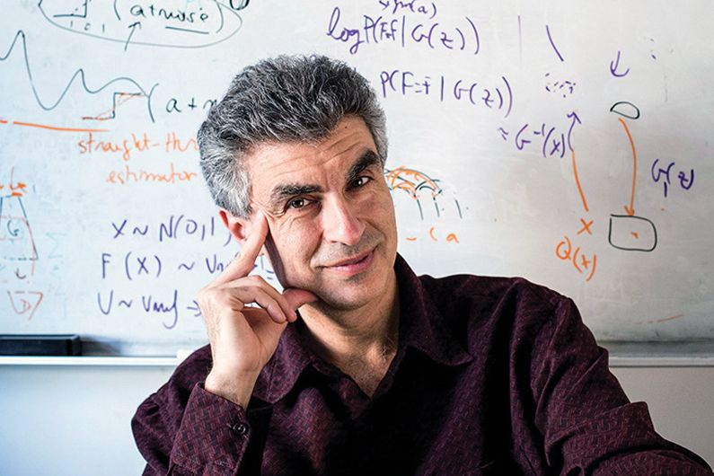
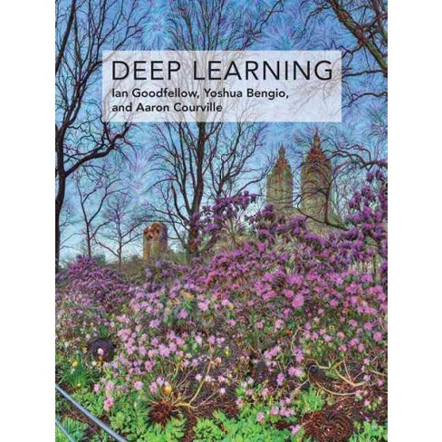
Three pioneers kept AI alive
Geoffrey Hinton
Yann LeCunn
Yoshua Bengio
“Grandfathers of AI”

Slide 4
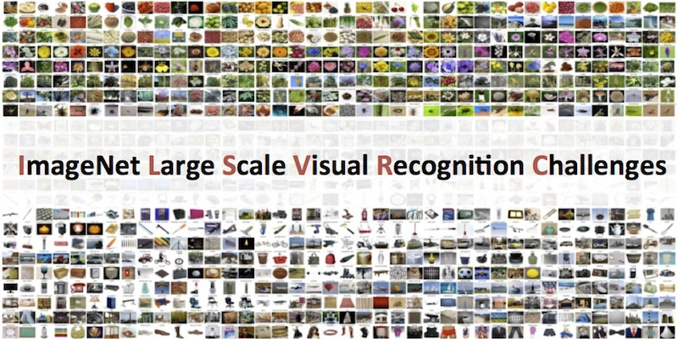
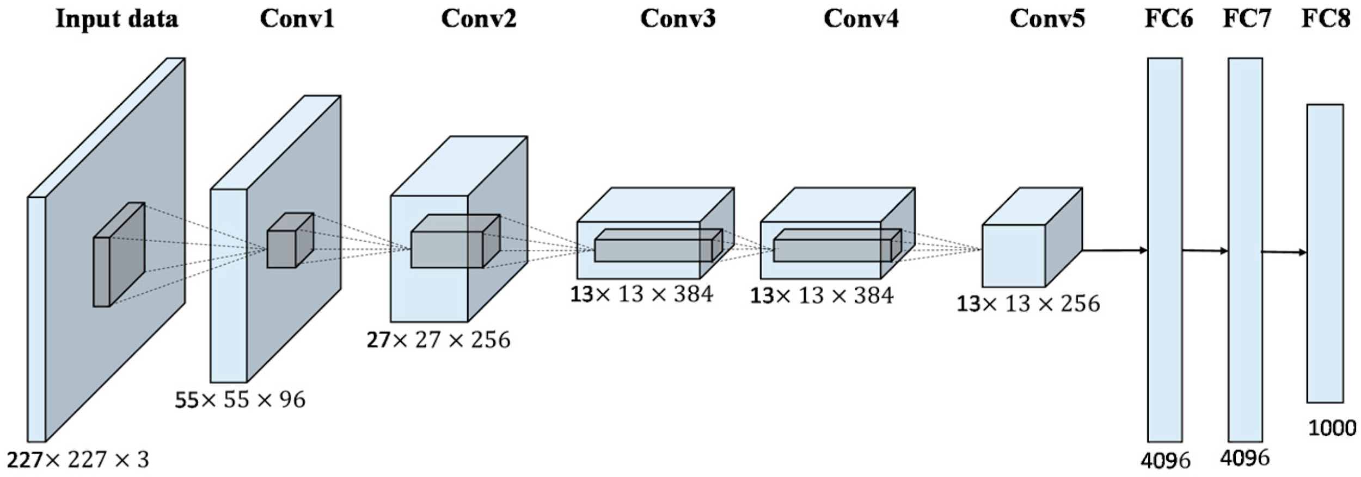
Why deep learning now?
Inflection point was in 2012 when convolutional net dominated the ImageNet Large Scale Visual Recognition Competition (ILSVRC)
Until 2010 the top methods predicted image classes with 75% accuracy
Incremental advances were fractions of a %
In 2012, researchers Alex Krizhevsky, Geoffrey Hinton, and Ilya Sutskever entered a ConvNet (now called Alexnet) into the challenge

Slide 5
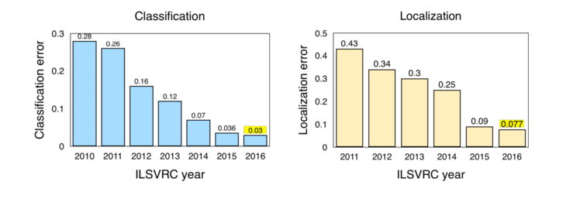
AlexNet shifted the stigma around Neural Netwroks
AlexNet could predict classes with an accuracy of ~85%
Human level accuracy is ~95%
Since AlexNet, all subsequent submissions used DL
In 2016 the contest was considered solved as most of the entries were reaching near-human level accuracy
Beats human level accuracy

Slide 6

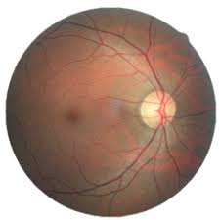
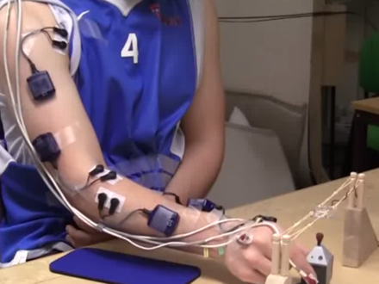
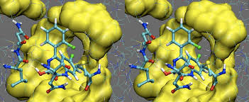
Kaggle has played an important in popularizing DL
In the early years Kaggle played an important role connecting tangible business outcomes with broader community adoption
Early adopters won $100Ks competitions
Examples include:
Grasp-and-Lift EEG Detection
Diabetic Retinopathy Detection
National Data Science Bowl
Right Whale Recognition
The Merck Molecular Activity Challenge
The Job Salary prediction challenge

Slide 7
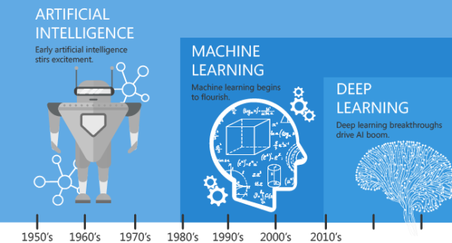
HOW DEEP LEARNING RELATES TO AI AND ML
AI was born in the 1950’s
Deep learning is a subset of artificial intelligence (AI) and machine learning (ML)
AI encompasses ML and other approaches that don’t use learning
Early chess programs use hard-coded rules, are a subset of the field of AI
This approach was known as symbolic AI
Reference to recent advances in AI they are to the advances deep learning and not canonic machine learning

Slide 8
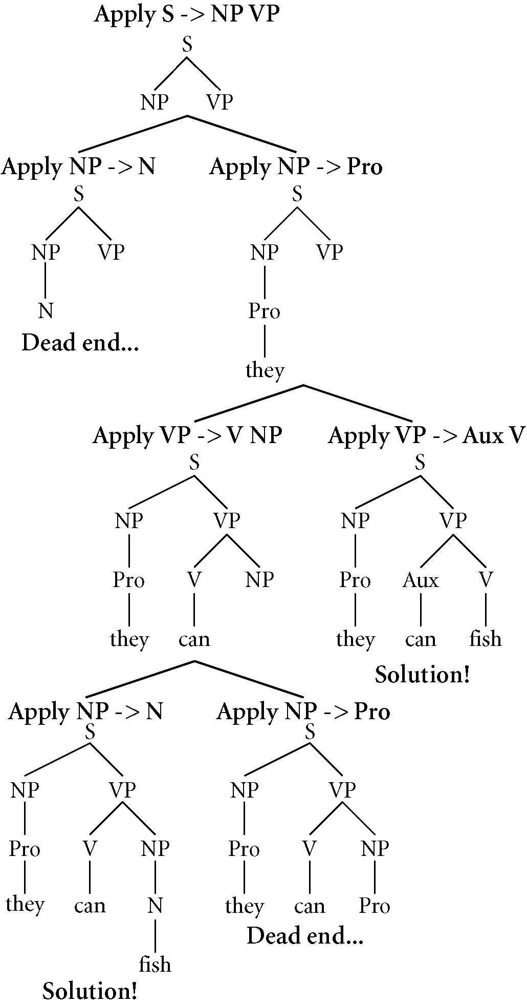
Symbolic AI was what people thought of as AI
Researchers postulated that for a sufficiently large rule-set human-level artificial could be achieved
Dominant paradigm in AI from the 1950s to the 1980s
Reached its peak with expert systems in the 1980s
We still use variants of it, we’ll see in our NLP section with recurrent networks

Slide 9
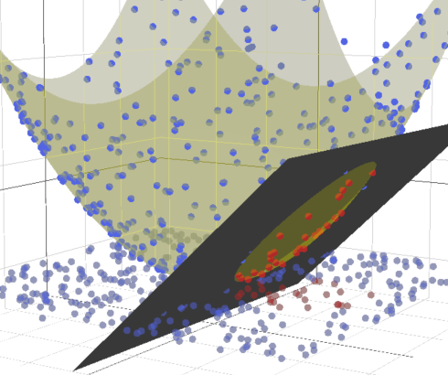
MACHINE LEARNING BEFORE DEEP LEARNING
Faster hardware and larger data sets have been drivers for ML flourishing since the 1990s
Towards the mid 2000s most improvements on problems and models were incremental and faced scaling, training and parallelization
Two popular approaches during this time were kernel and Bayesian approaches
SVMs have O(n^2) training complexity and do not scale well

Slide 10
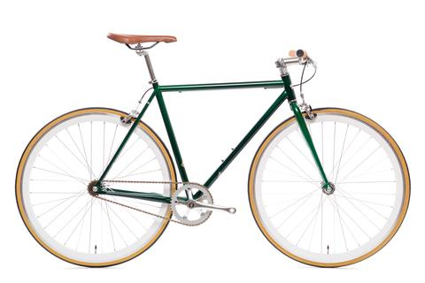
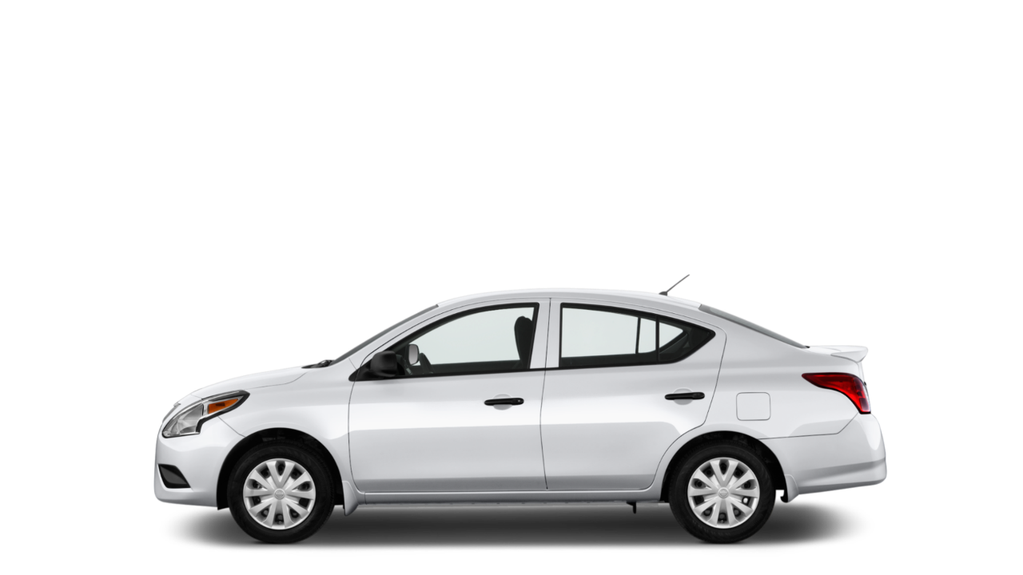
Shallow learning was machine learning
Successes in the 90s to the late 2000s were tackled with shallow models, single layer models
'Shallow models' assume a defined structure or relation to the data
For data that has low dimensional embeddings that are simple these models perform well
However as the complexity of the problem increases - shallow models require increased tuning and feature engineering to perform well.
Shallow models are like bikes whereas deep models are like cars

Slide 11
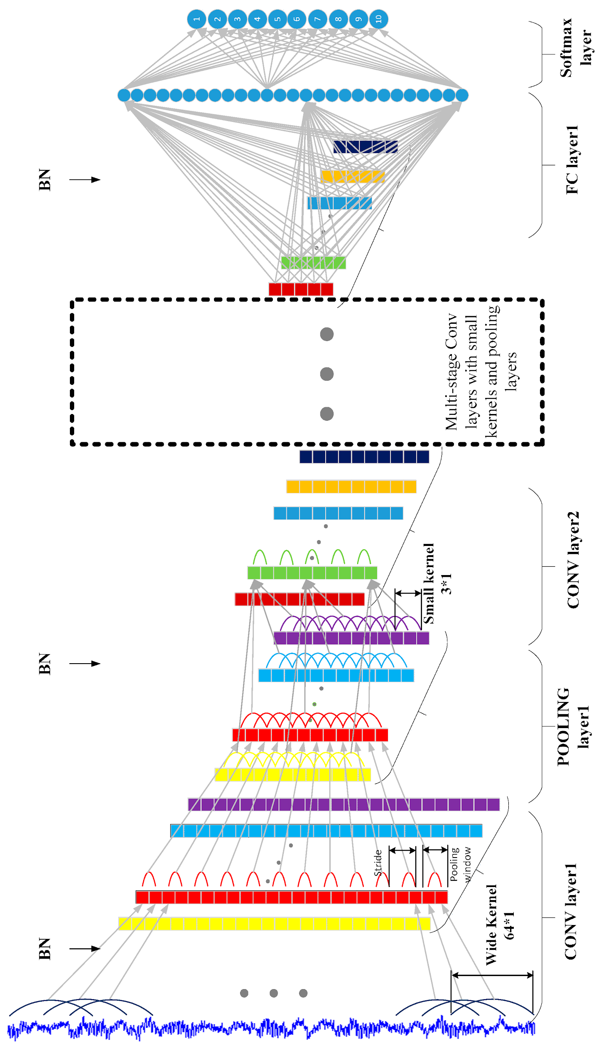
Shallow learning vs deep learning
Deep learning models stack simple models on top of one another generating hierarchical structures
They therefore have effect greater representational capacity
Whereas shallow models tend to make fairly complicated assumptions about the nature of the data, deep models make assumptions about network connectivity

Slide 12
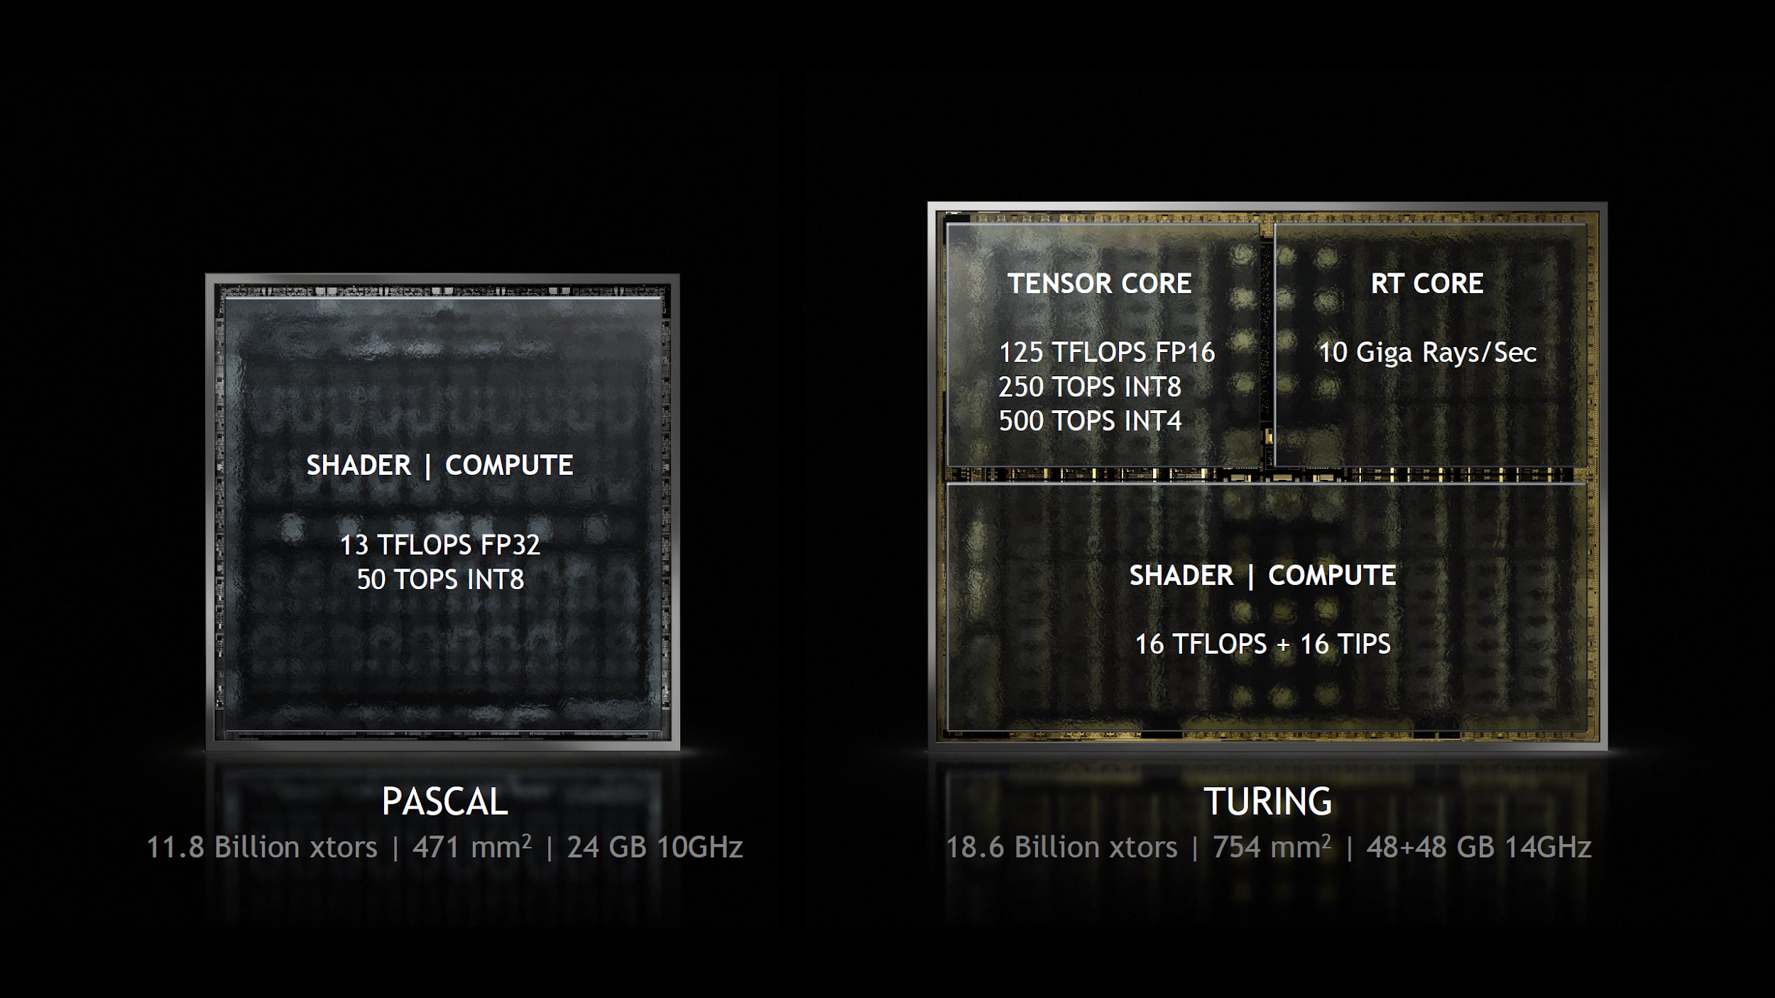
3 FACTORS CONTRIBUTING TO DL’S SUCCESSES
Hardware
Increase in speed
Increase in capacity
Gaming market subsidized supercomputing for the next gen of artificial intelligence
Data Speed and affordability - NVMe drives are 25x quicker than conventional HDDs - Cost per GB decreases yearly Availability - Easy access to data via APIs - Sites collect and share data
Amount
- The amount of data required to train a deep learning models is enormous
- In the early 2000s a standard hard drive had between 10-40Gb Most production-level corpora well exceed the 50Gb mark.
Algorithms Specialized algorithms - Developed to leverage general purpose hardware for DL
Algorithmic & research advances - Logistic vs ReLu networks - Embeddings - Batch norm - Residual networks - Attention

Slide 13
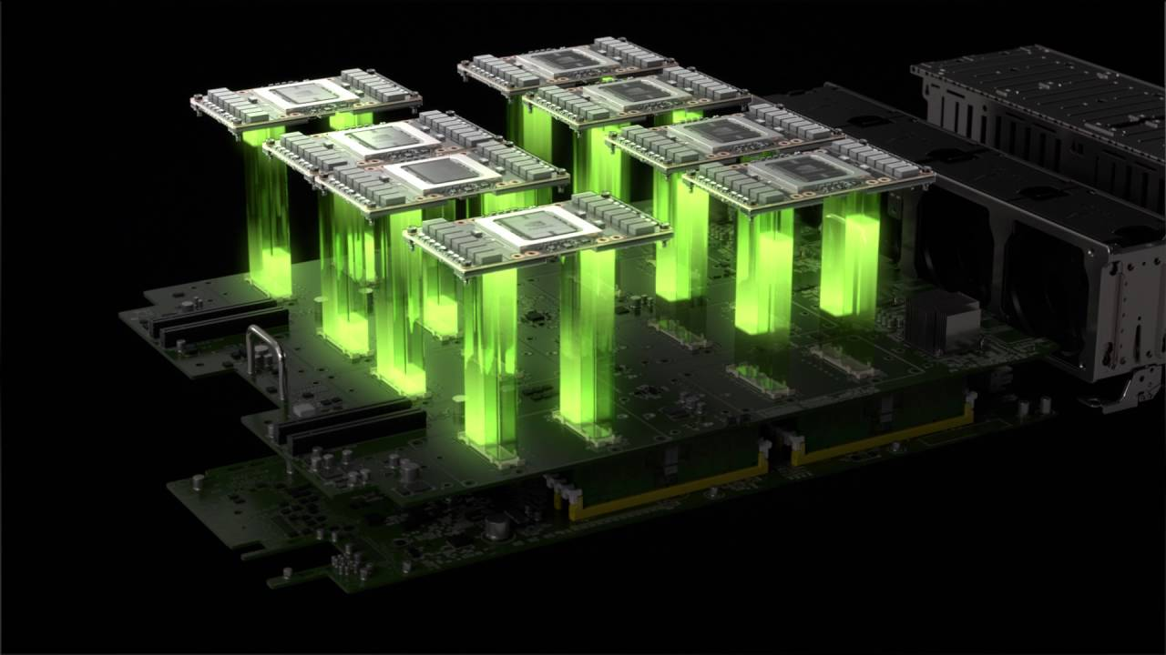
DEEP LEARNING IS NOT A PANACEA
Implementation limitations: - Deploying and leveraging commercial models requires building, deploying and productionizing DL systems - Requires real engineering expertise - As as the field advances, greater technical acumen will be required too
Data/hardware roadblocks:
- Online data is not production level data
- Papers produced by commercial researchers also frequently cite internally used data sets such as Google's Giga corpus
- DL hardware is expensive for the hobbyist or startup trying to break into the field
- NVIDIA's DGX-1 cluster computer costs >$100k.
- DL at scale is predominantly accessible to institutions that can fund the investment

Slide 14
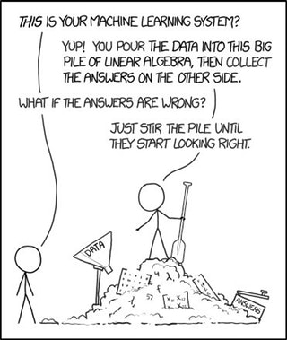
DL IN INDUSTRY
A less discussed aspect of DL are the lack of use-cases in industry
A good portion of research simply hasn't trickled into business
While several reasons may exist, three resonate
Large established firms that have the resources simply haven't made the investment to get up to speed ts who are growing quickly and well funded
The field is evolving so quickly that staying on top of the research isn't possible so the most salient use-cases fall by the way side in favor of more traditional implementations
Connecting business and DL models is hard

Slide 15
MOVING BEYOND ThE HYPE
Different levels of AI:
Artificial general intelligence (AGI) refers to machines being able to complete tasks at the human level
Strong AIs refers to machines capable of experiencing consciousness
- Most problems tackled by our current generation of researchers in AI seek to address weak or narrow AI as focused on one narrow task
- Many findings have not yet been applied to the broader range of industrial problems

